Slide 1

Web Scraping I

Slide 2
Motivation for Web Scraping
Relying on Downloadable CSV’s Puts You at a Disadvantage
Majority of Data Is Found Online
Negative: Online Data is Unstructured in HTML Format
Positive: Online Data is Often Updated, Relevant, & Untapped

Slide 3
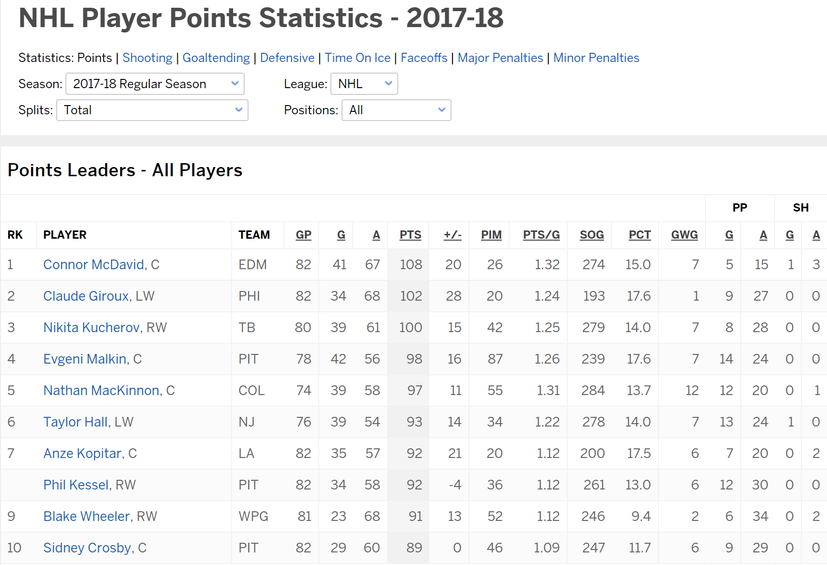
Motivation for Web Scraping
Example 1: ESPN NHL Stats

Slide 4
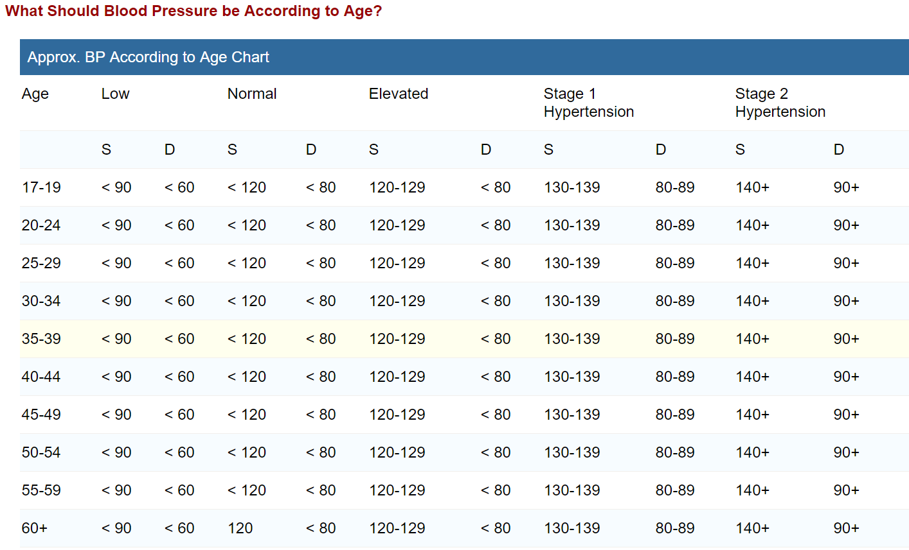
Motivation for Web Scraping
Example 2: Blood Pressure Chart

Slide 5
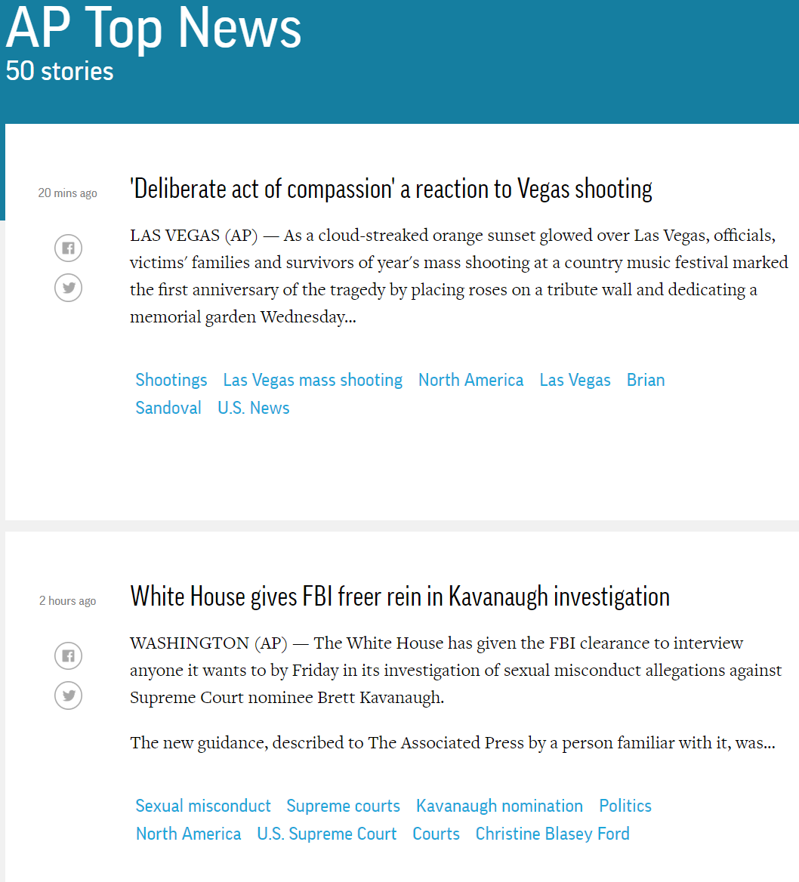
Motivation for Web Scraping
Example 3: AP Top 50 Stories

Slide 6
Web Scraping Defined
Process of Converting Currently Unstructured Data on Web to Structured Data in R
Ideas:
ESPN Table to CSV
Blood Pressure Chart to Tibble
Top News Stories to List in R
Absolutely Crucial Skill for Modern Data Scientists

Slide 7
Web Scraping in R
The rvest package
Written by Hadley Wickham
General Process:
> library(rvest)
Parse HTML
Extract Pieces You Want
Clean Information
URL

Slide 8
Tutorial 7 Introduction
Step 1: Open Tutorial 7
Step 2: Ensure You Have the Following R Packages Installed
tidyverse
rvest
Step 3: Knit the Document to Ensure Everything Works
Step 4: Read the Introduction
Approx. 5 Minutes

Slide 9
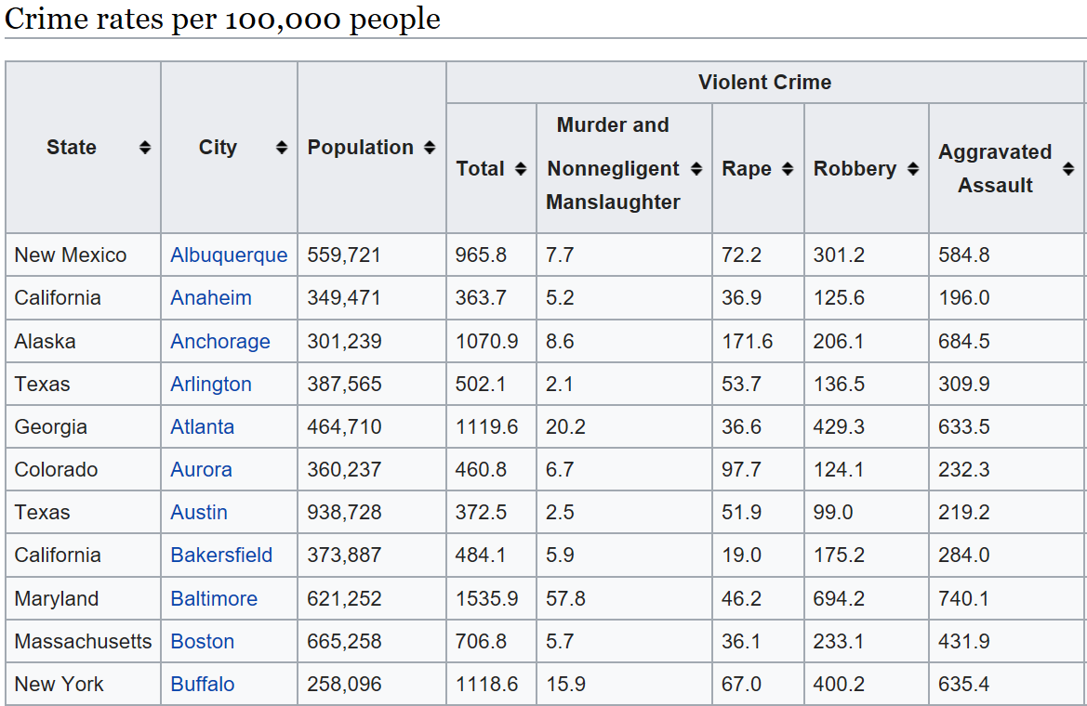
Part 1: Violent Crimes in US Cities
Step 1: Wikipedia Violent Crimes
Step 2: Locate the Table
Goal: Read Table Into R

Slide 10
Part 1: Violent Crimes in US Cities
Step 3: What Do You Expect to Be a Problem in the Data?
Step 4: Run Chunk 1
Is This What You Expected?
What New Problems Arise?
Step 5: Run Chunk 2
Select Wanted Information
Remove 1st Row – Subgroups
Rename Variables

Slide 11
Part 1: Violent Crimes in US Cities
Step 6: Run Chunk 3
Step 7: Run Chunk 4
Step 8: Knit Document

Slide 12
Closing
Disperse and Make Reasonable Decisions

